Slide 1
AKS Scalability
Notes:
These Learn modules are part of the AZ-204: Implement Azure App Service web apps (https://learn.microsoft.com/training/paths/create-azure-app-service-web-apps/) learning path.

Slide 2
Agenda
AKS Scaling Scenario
AKS Node Type
AKS Node Pool
AKS Scaling Cluster and Node Pool
Horizonal POD Scaling
Event Driven Scaling

Slide 3
AKS Scaling Scenario
Notes:
https://learn.microsoft.com/training/modules/introduction-to-azure-app-service/

Slide 4
A Scenario for AKS Scaling
XYZ Ltd have financial solutions for customers of different segment worldwide. XYZ Ltd already running customer workload in AKS hosted in Azure with multitenant model with strict isolation at Region level ( Separate cluster for each of US , Europe and APAC customer) . DevOps team manage the scale requirement customer workloads to meet the SLA for performance manually ( Manual or via script) . Now XYZ Ltd wants following ability to be included .
Automatic scale of nodes during day time (working time ) for USA regions
Automatic scale of Nodes when it reaches out required compute capacity to schedule new pods in APAC Region

Slide 5
POD workload auto scale on basic of on specific metrics:
1. CPU utilization:
Scenario: A web application experiences high traffic during peak hours, leading to increased CPU utilization on the pods.
HPA configuration: Configure HPA to scale up the number of pods when the average CPU utilization across pods exceeds a defined threshold (e.g., 80%). As CPU usage decreases, HPA scales down pods to optimize resource usage.
2. Memory utilization:
Scenario: A memory intensive application experiences increased memory consumption during specific processing tasks.
HPA configuration: Set HPA to scale up pods when the average memory utilization across pods surpasses a defined threshold (e.g., 70%). This ensures sufficient memory availability for the application.
3. Concurrent requests:
Scenario: An API service experiences bursts of concurrent requests, requiring additional pods to handle the load effectively.
HPA configuration: Configure HPA to scale based on the number of concurrent requests or connections to the service. As the number of requests increases, HPA scales up pods to maintain responsiveness.
4. Queue length:
Scenario: A message queue processing application experiences a backlog of messages, requiring more pods to process them efficiently.
HPA configuration: Set HPA to scale based on the length of the message queue. As the queue length grows, HPA scales up pods to accelerate message processing and reduce backlog.

Slide 6
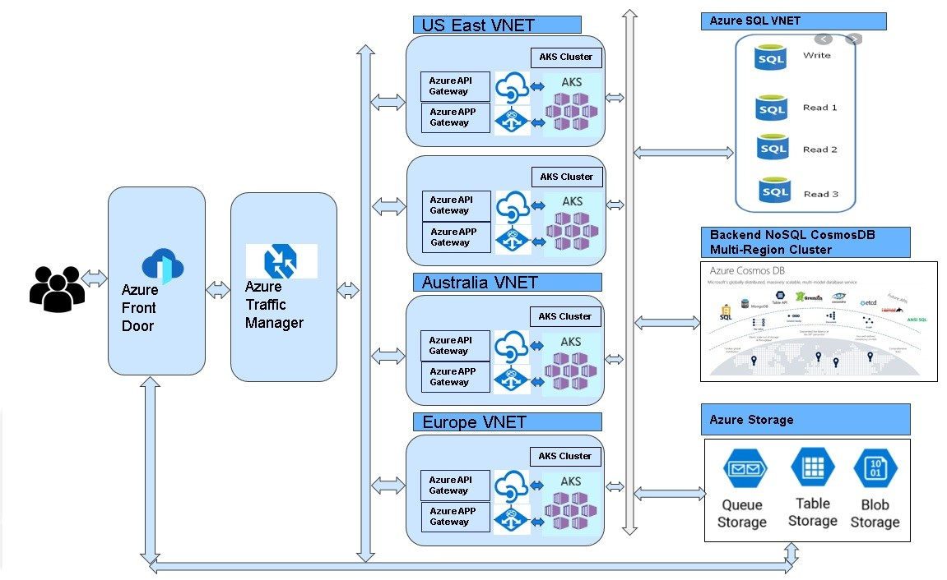

Slide 7
AKS Nodes
Notes:
https://learn.microsoft.com/training/modules/introduction-to-azure-app-service/

Slide 8
Node Types in AKS
VirtualMachineScaleSets
AvailabilitySet
Virtual Node
LowPriority

Slide 9
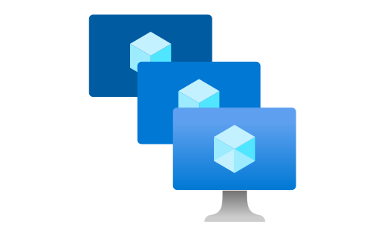
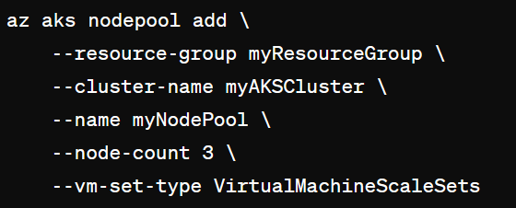
Virtual Machine Scale Set (Default)
Specifies that the nodes in the node pool will be deployed as instances of Azure Virtual Machine Scale Sets (VMSS).
VMSS automatically scales the number of VM instances based on demand or a defined schedule, providing high availability and scalability for your applications.
Notes:
az aks create -g aksdemo1 -n bipeenclus02 --kubernetes-version 1.27.7 --vm-set-type AvailabilitySet

Slide 10
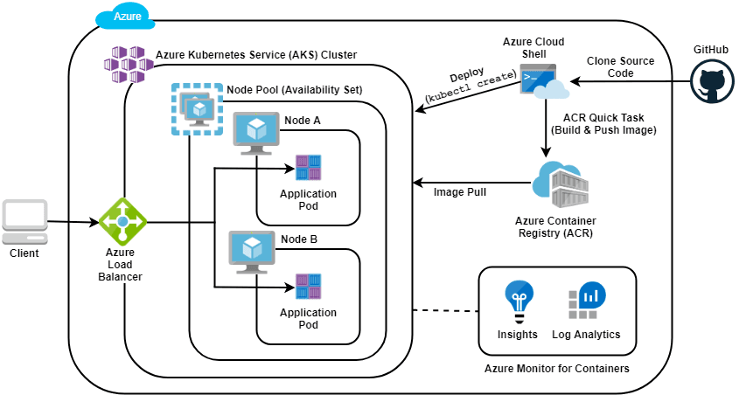
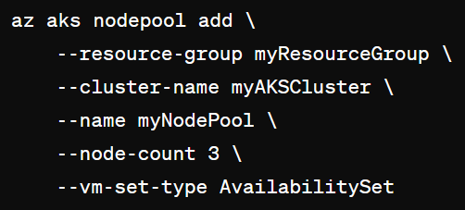
Availability Set
Specifies that the nodes in the node pool will be deployed as individual VMs within an Azure availability set.
An availability set ensures that the VMs are distributed across multiple fault domains and update domains for increased availability.

Slide 11
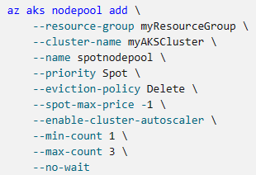
Low Priority VM ( Spot Instance)
A Spot node pool is a node pool backed by an Azure Spot Virtual machine scale set.
With Spot VMs in your AKS cluster, you can take advantage of unutilized Azure capacity with significant cost savings.
The amount of available unutilized capacity varies based on many factors, such as node size, region, and time of day.
https://learn.microsoft.com/en-us/azure/aks/spot-node-pool
Notes:
Azure cloud is often underutilized, customers do not use lots of computing power. This unused capacity led Microsoft to offer a new type of Virtual Machines – Spot Instances. They are a lot cheaper than a normal VM and can be evicted at any time. This makes spot instances ideal for development & test environments, but not so much for production. Unless you are fully aware of how spot instances work and what risks they have, you should not apply this to production environments.

Slide 12
AKS Node Pool
Notes:
https://learn.microsoft.com/training/modules/introduction-to-azure-app-service/

Slide 13
A node pool is a collection of VMs (usually backed by a Virtual Machine Scale Set (VMSS)) that can participate in a Kubernetes cluster.

Slide 14
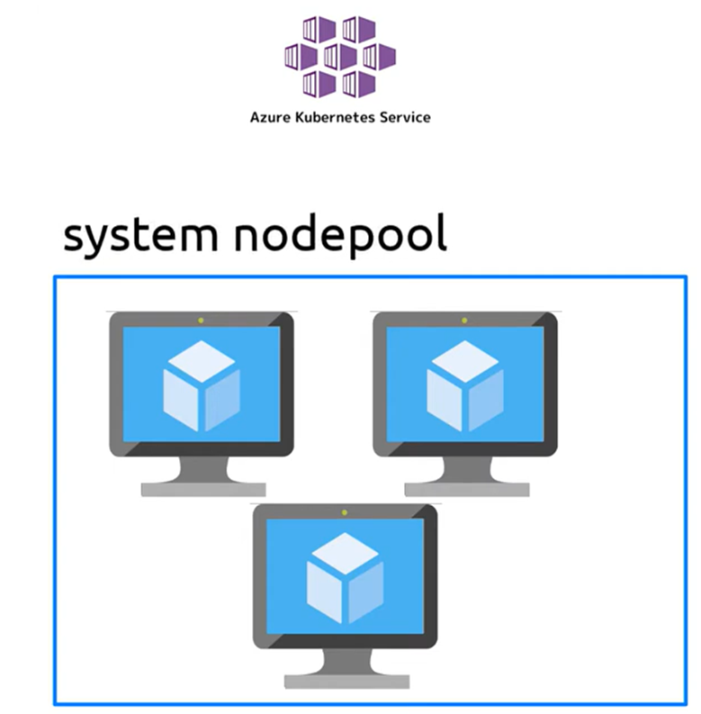
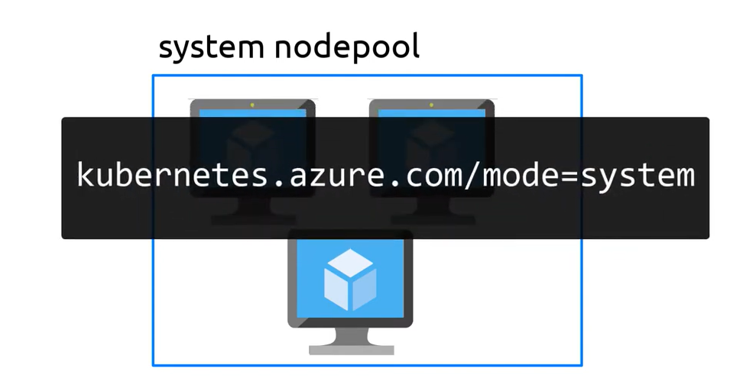
System Node Pool

Slide 15
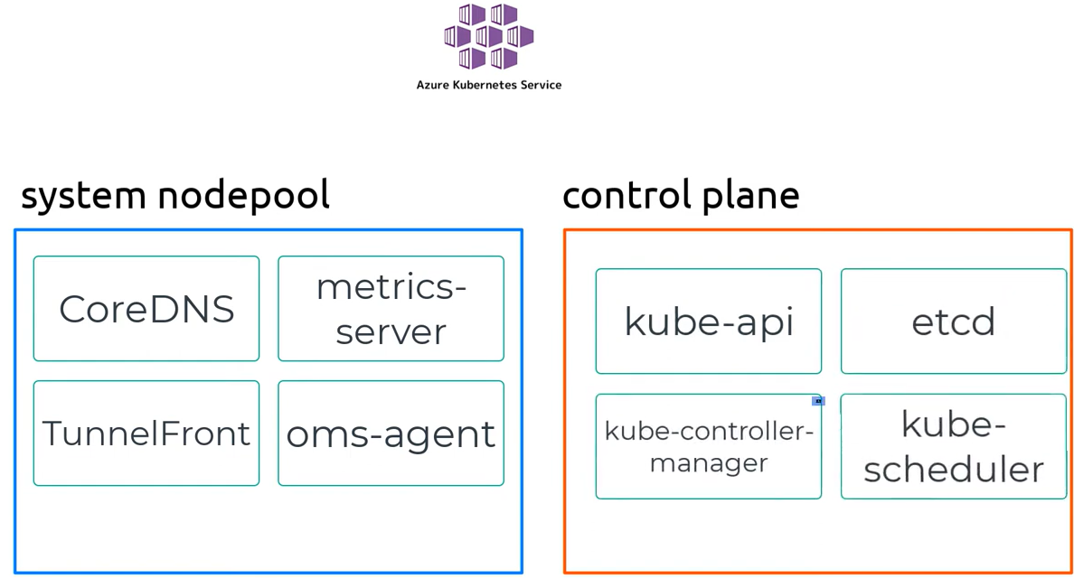
System Node Pool vs Control Panel

Slide 16
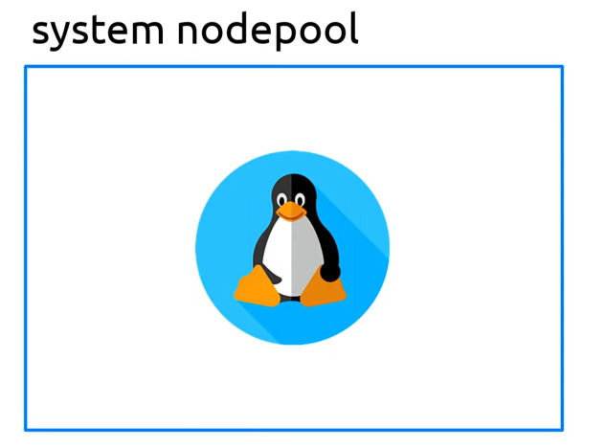
System Node Pool
Only Linux
At least one System Node Pool required

Slide 17
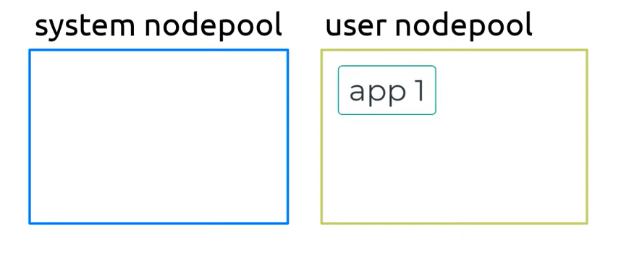
System Node Pool vs User Node pool

Slide 18
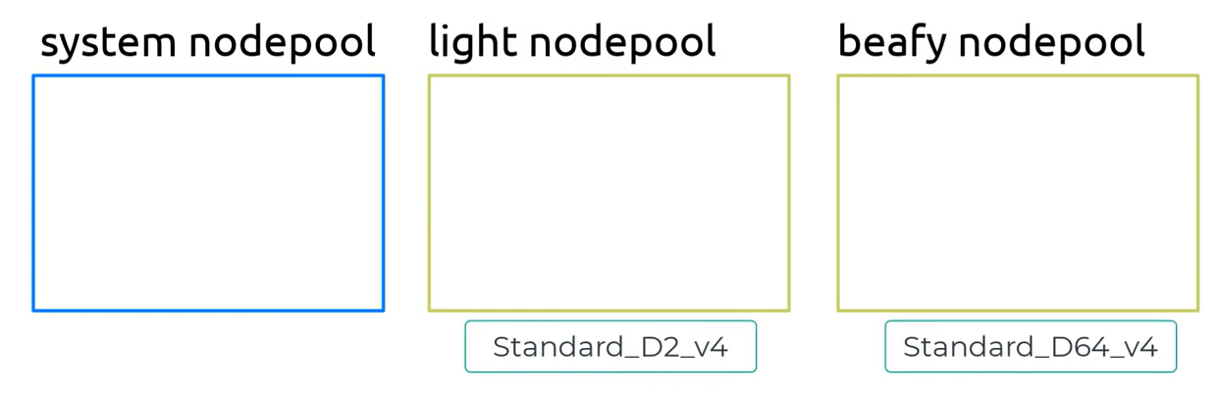
Dedicated SKU for Node Pool

Slide 19
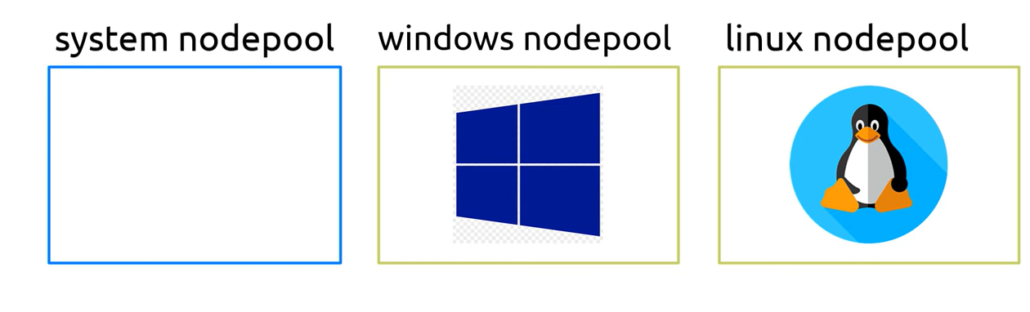
Dedicated OS for Node Pool

Slide 20
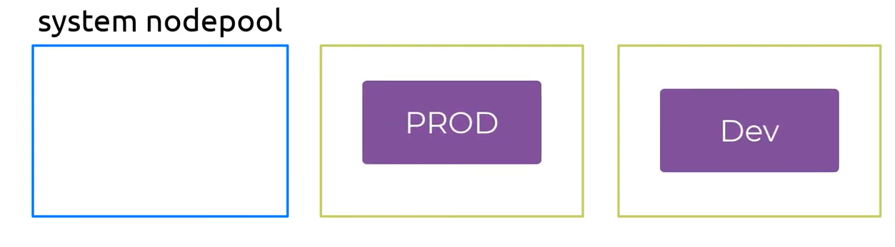
Dedicated SKU for Node Pool

Slide 21
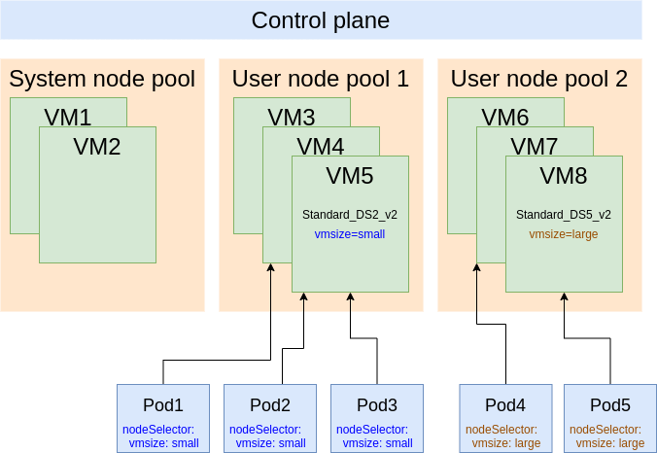

Slide 22
AKS Autoscaling ( Cluster and Node pool Autoscaling)
Notes:
https://learn.microsoft.com/training/modules/introduction-to-azure-app-service/

Slide 23
Autoscaling Options in AKS
Cluster Autoscale:
Node Pool Autoscale
POD Autoscale:
Horizontal Pod Autoscale (HPA):
Vertical Pod Autoscale (VPA):
Event-Driven Autoscaling
POD Autoscale with Keda
Trigger Cluster Autoscale with Azure Function

Slide 24
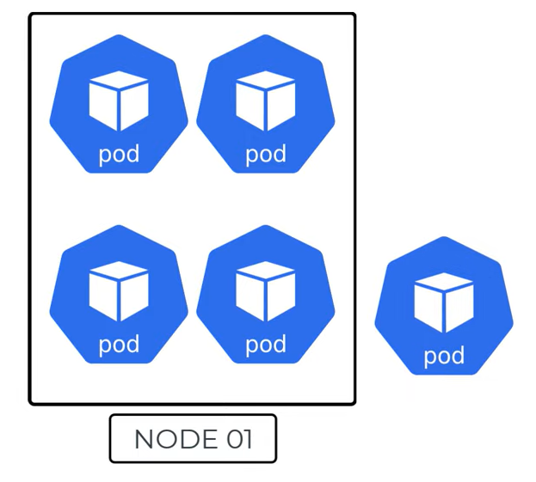
Node Autoscaling Requirement
What happen when compute resources on node 1 exhausted and you need another pod to schedule ?

Slide 25
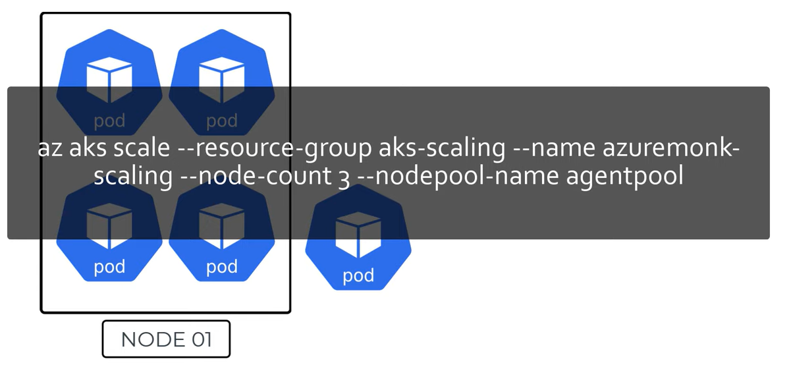
Manual Method of scaling Node

Slide 26
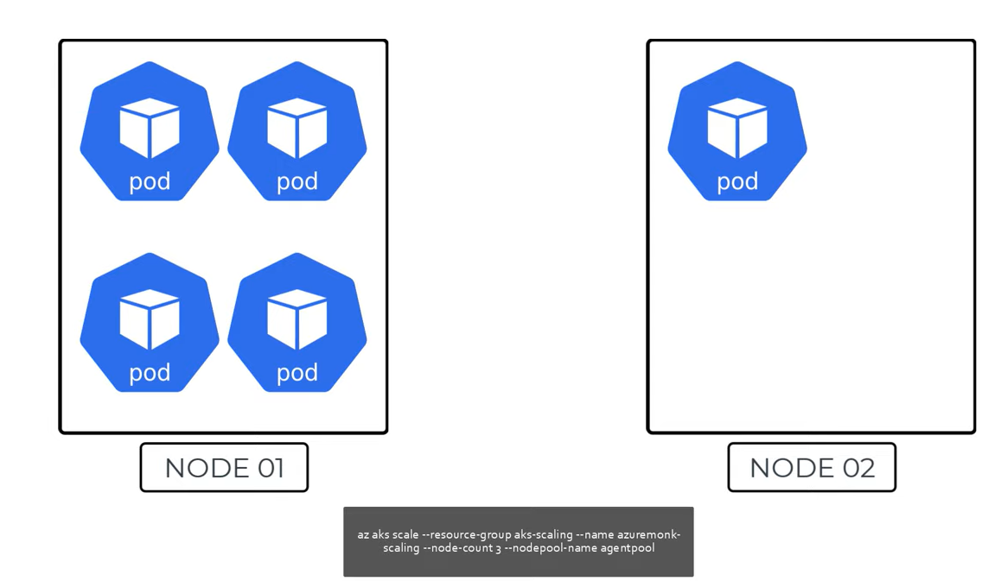
Node Manual Scaling

Slide 27
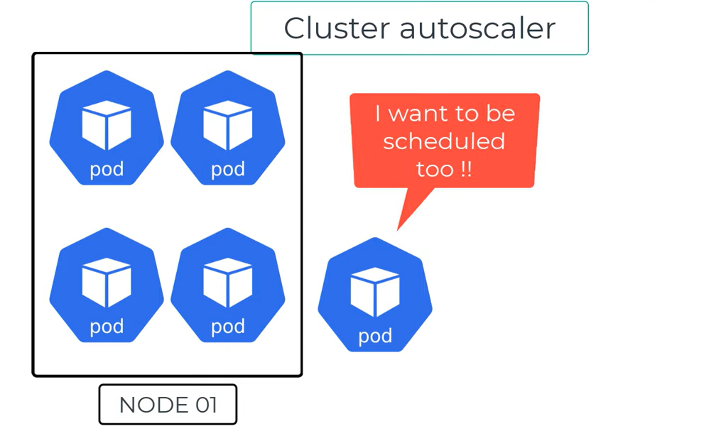

Slide 28
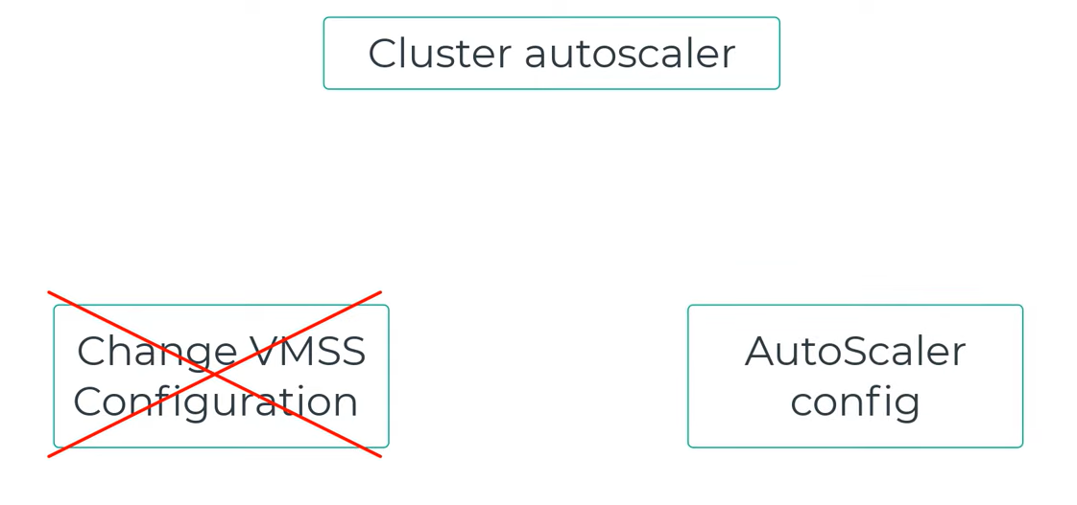

Slide 29
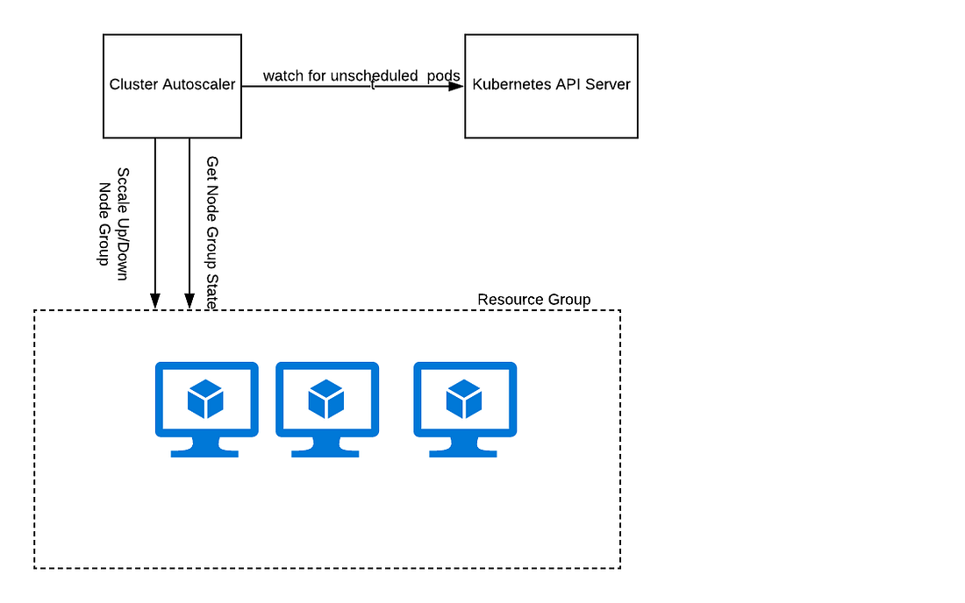
Cluster Autoscale
Automatically adjusts the number of nodes in a Kubernetes cluster based on resource demand.
Scales the entire cluster up or down to meet workload requirements.
Helps optimize resource utilization and reduce costs during periods of low demand.

Slide 30
How to Enable Cluster AutoScaler in AKS
There is no option to directly enable cluster autoscaling during AKS cluster creation through the Azure portal.
However, you can easily enable it after the cluster has been created:
1. Using the Azure portal:
Go to your AKS cluster resource in the portal.
Select the "Scaling" option from the left-hand menu.
Under "Cluster autoscaling," toggle the switch to "On."
Define the desired minimum and maximum number of nodes for the cluster.
Click "Save" to apply the changes.
2. Using Azure CLI:
Use the az aks update command with the --enable-cluster-autoscaler flag and specify the desired minimum and maximum node count.
3. Using ARM templates:
Include the enableClusterAutoscaler property and define the minNodeCount and maxNodeCount within the cluster definition
Notes:
Cli command : az aks create --resource-group <resource-group> --name <cluster-name> --kubernetes-version 1.12.4 \--node-count 1 --node-vm-size Standard_DS1_v2 \--vnet-subnet-id "/subscriptions/xxxx-xxxx-xxxxxxxxxxx/resourceGroups/xxxxxx/providers/Microsoft.Network/virtualNetworks/k8s-vnet/subnets/k8s-nodes-subnet" \--network-plugin azure \--service-cidr 10.20.0.0/16 --dns-service-ip 10.20.0.10 \--enable-cluster-autoscaler \--min-count 1 \--max-count 3

Slide 31
Use the cluster autoscaler on node pools
You can use the cluster autoscaler with multiple node pools and can enable the cluster autoscaler on each individual node pool and pass unique autoscaling rules to them.
az aks nodepool update \
--resource-group myResourceGroup \
--cluster-name myAKSCluster \
--name nodepool1 \
--update-cluster-autoscaler \
--min-count 1 \
--max-count 5

Slide 32
Cluster Autoscale vs Node Pool Autoscale
Node pool autoscaling can be enabled independently of cluster autoscaling in AKS.
This means you can have node pools that automatically scale based on specific metrics and thresholds, even if cluster autoscaling is not enabled for the entire cluster.
.
Cluster autoscaling:
Scales the total number of nodes in the cluster based on pod resource requests and scheduling requirements.
Operates at the cluster level and applies to all node pools within the cluster.
Ensures sufficient resources are available for all pods across the cluster.
Node pool autoscaling:
Scales the number of nodes within a specific node pool based on defined metrics and thresholds.
Offers granular control over the scaling behavior of individual node pools.
Can be used to optimize resource utilization and cost for specific workloads or node pool types

Slide 33
Scenarios for using node pool autoscaling without cluster autoscaling:
You have a specific node pool dedicated to a particular workload with predictable scaling needs.
You want to optimize resource usage and cost for a specific node pool based on custom metrics.
You want to maintain a minimum number of nodes in a specific node pool for availability or performance reasons.
Important considerations:
If you use node pool autoscaling without cluster autoscaling, ensure that the overall cluster size is sufficient to accommodate all scheduled pods.
Monitor resource usage and scaling behaviour to ensure optimal performance and cost efficiency.

Slide 34
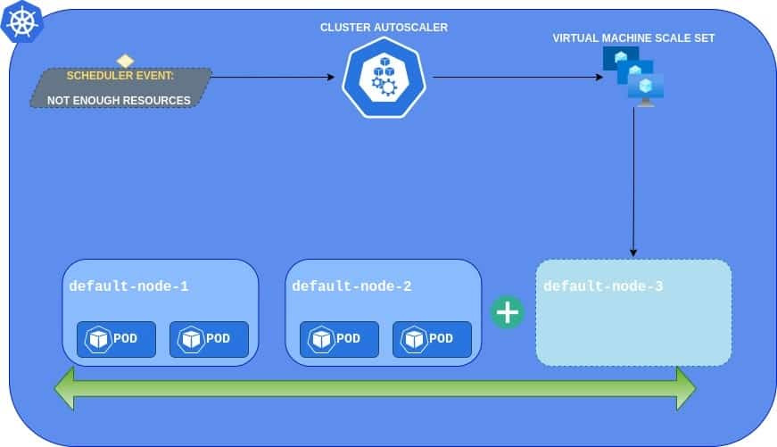

Slide 35
Scale-down modes

Slide 36
In AKS, node pools can be configured with auto-scaling using different scale-down modes, which determine how nodes are removed from the pool when they are no longer needed. The two main scale-down modes are
Delete
Deallocate
Notes:
Can we use Delete and Dellocate mode both ?
Yes, you can use deallocate and delete modes for different node pools within the same AKS cluster.

Slide 37
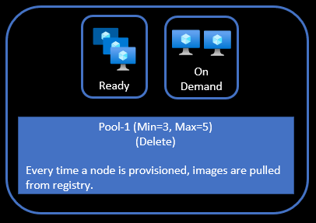
Delete Scale-Down Mode
In the “Delete” scale-down mode, nodes are completely deleted from the node pool when they are no longer needed.
This means that any data, container images, and applications running on the node will be lost, and the node will need to be recreated if it is needed again.
By default, AKS creates a nodepool in delete scale-down mode -

Slide 38
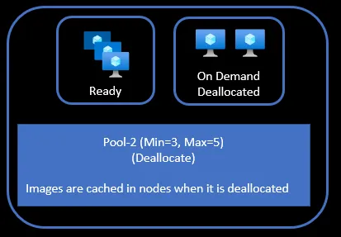
Deallocated Scale-Down Mode
When a node is deallocated, the container images, and node configuration, are preserved on the node, allowing for faster operation speeds if it is restarted later.
Additionally, when an Azure Virtual Machine is in the Stopped (Deallocated) state, you will not be charged for the VM compute resources. You will only need to pay for any OS and data storage disks attached to the VM.

Slide 39
az aks nodepool add \ --resource-group myResourceGroup \ --cluster-name myAKSCluster \ --name nodepool1 \ --enable-cluster-autoscaler \ --min-count 1 \ --max-count 5 \ --scale-down-mode Deallocate

Slide 40
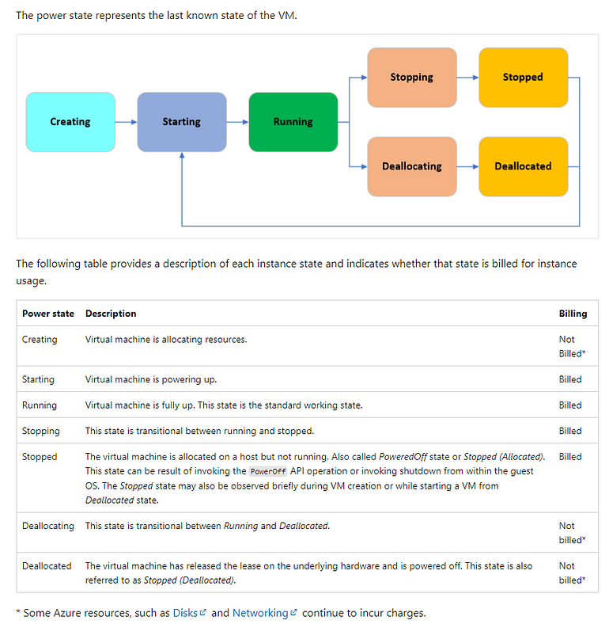
Notes:
Here are some factors to consider when choosing between the “Delete” and “Deallocate” scale-down modes:
Statefulness: If your application requires persistent data storage and can’t tolerate losing nodes, then the “Deallocate” scale-down mode may be a better choice. If your application is stateless and can recover from node failures, then the “Delete” scale-down mode may be sufficient.
Cold-start time: If your application requires fast scaling and reduced cold-start times, then the “Deallocate” scale-down mode may be a better choice. If your application can tolerate longer start-up times, then the “Delete” scale-down mode may be sufficient.
Cost: The “Deallocate” scale-down mode may be more cost-effective in scenarios where you need to scale up and down frequently, as it allows you to save on compute costs while keeping your data intact. The “Delete” scale-down mode may be more cost-effective in scenarios where you have a stable workload and don’t need to scale up and down frequently.
Availability: If your workload requires high availability and can’t tolerate node failures, then the “Deallocate” scale-down mode may be a better choice, as it allows you to quickly reactivate nodes if needed. If your workload can tolerate node failures and can automatically recover from them, then the “Delete” scale-down mode may be sufficient.

Slide 41
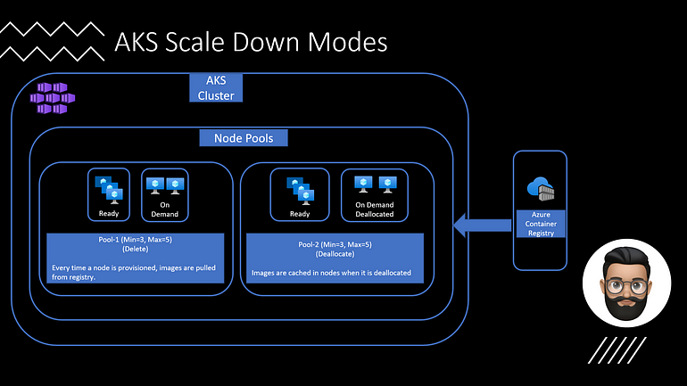
Notes:
Can we use Delete and Dellocate mode both ?
Yes, you can use deallocate and delete modes for different node pools within the same AKS cluster.

Slide 42
Scaling with Azure Container Instance

Slide 43
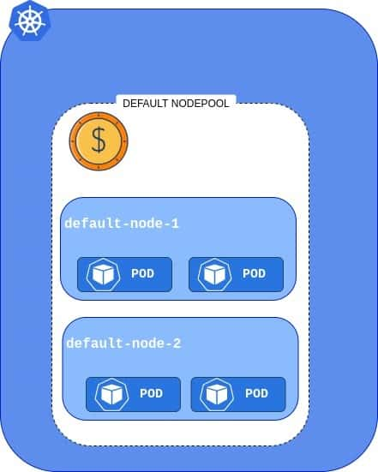
Let’s take a look at how default AKS looks like in terms of Node Pools – a cluster with a single, expensive Node Pool ( E.G User Node pool)

Slide 44
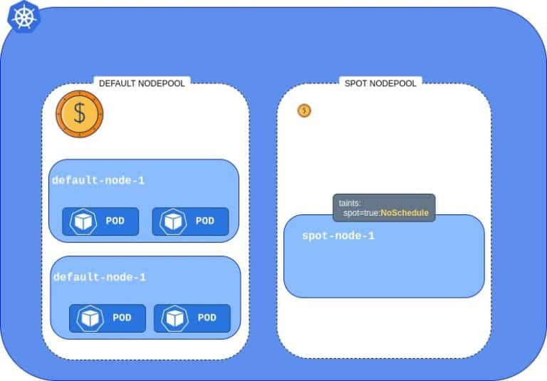
Now, what happens if we add the cheap Spot Instance Pool?
We can see that the cluster now has two Node Pools, but the one we added is a little different – it has a special taint. It makes the new Spot Pool unavailable for all workloads.

Slide 45
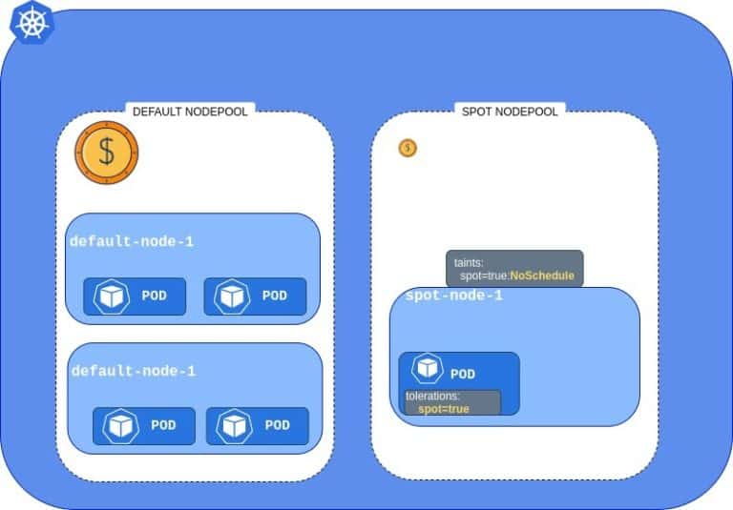
One possible solution is to adjust our deployments’ YAML files and add a toleration, which will allow Pods to be scheduled on the tainted Node.

Slide 46
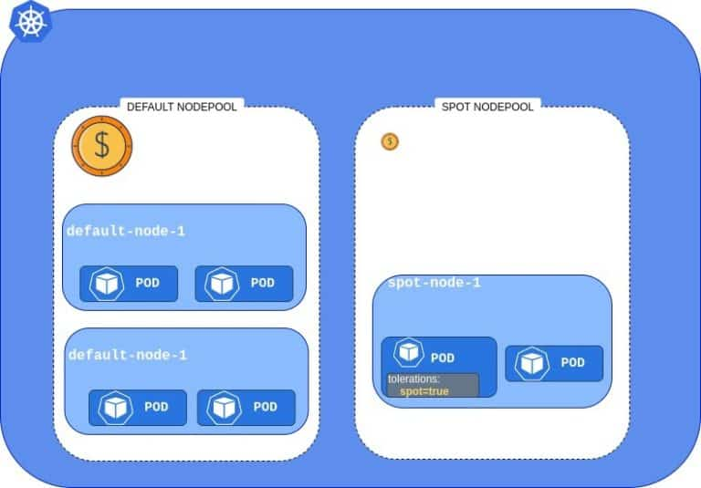
However, if you don’t want to change your deployments and allow every workload to run on cheap nodes, you can do it by automatically un-tainting Spot Instance nodes.
This way all pods will be able to utilize Spot Instance

Slide 47

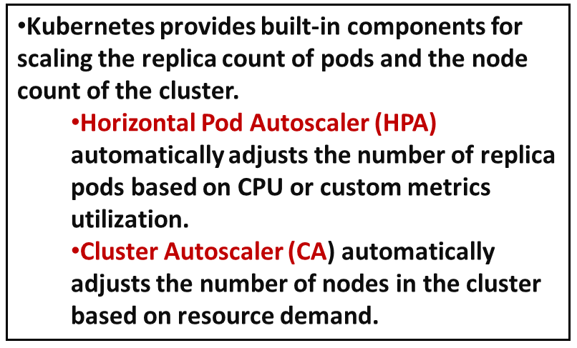
In scenarios where the application needs to rapidly scale, HPA may schedule more pods than the existing compute resources in the node pool can accommodate.
Solutions
Limitation
Node Provisioning Time
Delay in Pod Scheduling:

Slide 48
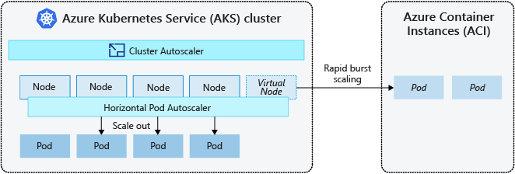
Burst to Azure Container Instances (ACI)
ACI lets you quickly deploy container instances without extra infrastructure overhead. When you connect with AKS, ACI becomes a secured, logical extension of your AKS cluster.
The virtual nodes component, which is based on virtual Kubelet, is installed in your AKS cluster that presents ACI as a virtual Kubernetes node. Kubernetes can then schedule pods that run as ACI instances through virtual nodes, not as pods on VM nodes directly in your AKS cluster.

Slide 49
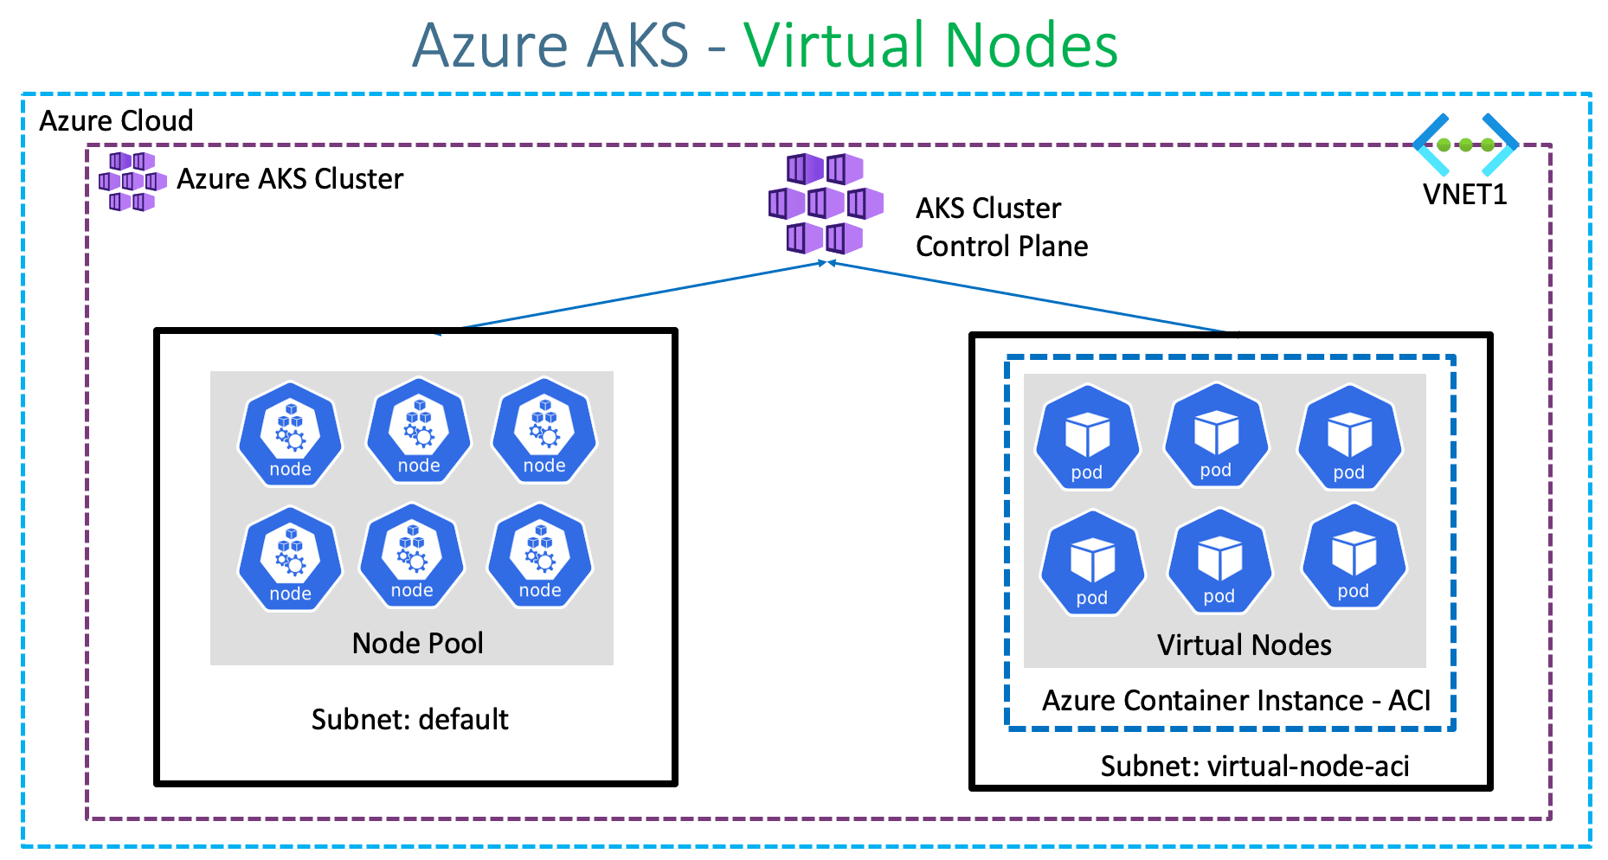
Notes:
Virtual nodes are deployed to another subnet in the same virtual network as your AKS cluster. This virtual network configuration secures the traffic between ACI and AKS. Like an AKS cluster, an ACI instance is a secure, logical compute resource isolated from other users.

Slide 50
Horizontal POD Autoscaling

Slide 51
HPA scales the number of pod replicas within a Deployment, ReplicaSet, or StatefulSet based on resource utilization metrics.
CA scales the number of nodes in the Kubernetes cluster to accommodate the demand for running pods as determined by HPA and other factors such as resource constraints.

Slide 52
Benefits of horizontal autoscaling
Horizontal autoscaling in Azure Kubernetes Services (AKS) offers a number of benefits, including:
Scalability: AKS can automatically increase or decrease the number of PODs in a cluster based on workload demands, ensuring that resources are always available when needed.
Improved performance: Horizontal autoscaling ensures that the cluster can handle sudden spikes in traffic and reduce latency for users.
Cost optimization: By scaling PODs up or down as needed, you can avoid paying for unused resources and optimize costs.
Improved availability: If a node fails, AKS can automatically replace it, improving the overall reliability and availability of your application.
Automation: The entire process of scaling is automated, reducing the need for manual intervention and minimizing the risk of errors.

Slide 53
How does Horizontal Pod Autoscaler works?
Horizontal POD Autoscaler works in this fashion:
Horizontal Pod Autoscaler (HPA) automatically adjusts the number of pods in a deployment, replication controller, or replica set, stateful set depending on the CPU utilization of those resources.
By setting a target CPU usage percentage, the HPA automatically adds or removes pods to meet that goal.
Kubernetes metrics server is used by the HPA to verify CPU metrics for each pod.
The HPA does not need to be manually installed – it is available as an API resource in Kubernetes by default.
Notes:
Cluet

Slide 54
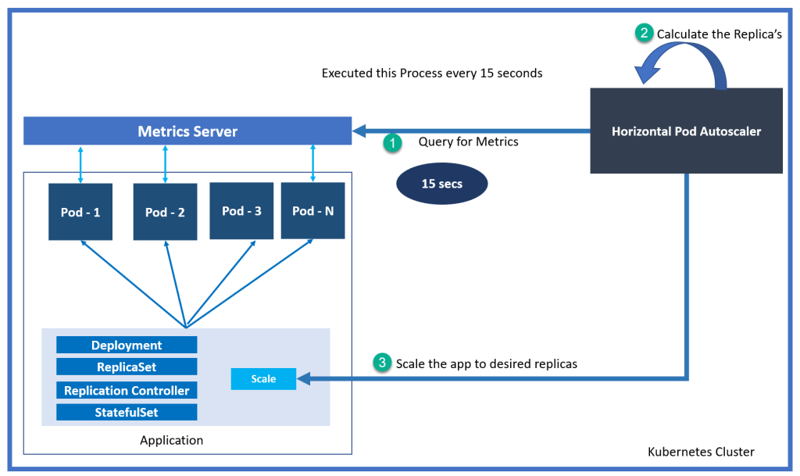

Slide 55
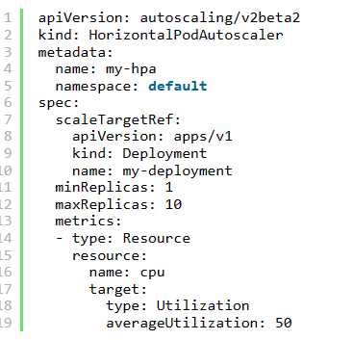
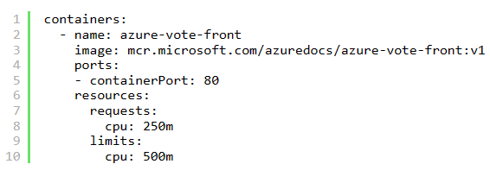
1. Create a manifest file to define Autoscaler behavior:
2. Define the resource info while creating the YAML
Enable horizontal pod autoscaling via kubectl
This option is most suitable if you have not defined it in the YAML file while creating it: Here is the example:
kubectl autoscale deployment myapp --cpu-percent=50 --min=3 --max=10
kubectl apply -f manifest.yaml

Slide 57
What triggers horizontal autoscaling in AKS?
Horizontal autoscaling in AKS is triggered when the utilization of a specified resource (such as CPU or memory) exceeds a defined threshold. The HorizontalPodAutoscaler object defines the conditions that trigger scaling.
How does AKS determine the number of replicas to add or remove?
The AKS HorizontalPodAutoscaler calculates the desired number of replicas based on the current utilization of the specified resource and the target utilization specified in the HPA object.
Can I set different autoscaling rules for different resources?
Yes, you can specify different autoscaling rules for different resources (such as CPU and memory) in the same HPA object.

Slide 58
How do I monitor horizontal autoscaling in AKS?
You can use the kubectl get hpa command to see the current status of the HPA, including the current number of replicas, target utilization, and conditions that triggered scaling.
Can I manually scale the number of replicas in AKS?
Yes, you can manually scale the number of replicas in AKS using the kubectl scale command. However, it’s recommended to let the HorizontalPodAutoscaler handle scaling automatically to ensure optimal resource utilization and cost efficiency.
Is horizontal autoscaling available in all AKS pricing tiers?
Yes, horizontal autoscaling is available in all AKS pricing tiers and is included in the standard AKS pricing.
How does horizontal autoscaling affect my AKS costs?
Horizontal autoscaling can help optimize your AKS costs by automatically scaling the number of nodes up or down as needed, avoiding the costs associated with unused resources. However, be aware that scaling nodes up will result in higher costs.

Slide 59
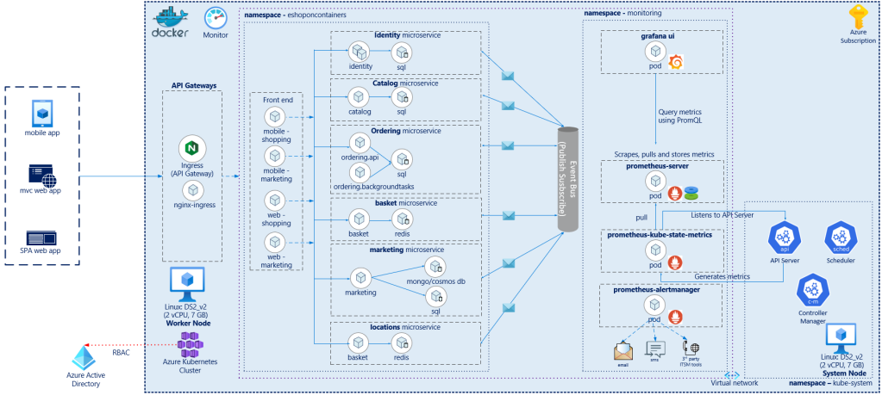
e-commerce reference application eShopOnContainers here. eShopOnContainers is comprised of a microservice based e-commerce website deployed on docker containers
Notes:
https://github.com/dotnet-architecture/eShopOnContainers/wiki/Architecture#internal-architectural-patterns

Slide 60
Below are some key considerations based on which the application was deployed on Azure AKS.
Helm chart based application deployment
Nginx ingress containers as API Gateways or load balancer.
Grafana and Prometheus on containers being used for monitoring the resource usage.
SQL and Redis on containers for data store and cart management
Linux based Azure VM(Ds2 v2) for both system and worker nodes

Slide 61
Implementing HPA!!
Ensure all pods have resource requests specified
Install metrics-server
Configure custom or external metrics(metric configured in values.yml)
Configure cool-down period( set stabilizationWindowSeconds flag in hpa.yaml)

Slide 62
HPA.yaml
apiVersion: autoscaling/v2beta2
kind: HorizontalPodAutoscaler
metadata:
name: {{ include "webmvc.fullname" . }}
labels:
app: {{ template "webmvc.name" . }}
chart: {{ template "webmvc.chart" . }}
release: {{ .Release.Name }}
heritage: {{ .Release.Service }}
spec:
scaleTargetRef:
apiVersion: apps/v1
kind: Deployment
name: {{ template "webmvc.fullname" . }}
minReplicas: {{ .Values.hpa.minReplicas }}
maxReplicas: {{ .Values.hpa.maxReplicas }}
metrics:
- type: Resource
resource:
name: cpu
target:
type: Utilization
averageUtilization: {{ .Values.hpa.targetCPUUtilizationPercentage }}
behavior:
scaleDown:
stabilizationWindowSeconds: 300

Slide 63
Value.yaml
hpa:
enabled: true
minReplicas: 1
maxReplicas: 5
targetCPUUtilizationPercentage: 50
resources:
limits:
cpu: 250m
memory: 256Mi
requests:
cpu: 100m
memory: 128Mi
Declaratively setting the cpu Limits and Requests. Requests and limits are the mechanisms Kubernetes uses to control resources such as CPU and memory.
Requests are what the container is guaranteed to get. If a container requests a resource, Kubernetes will only schedule it on a node that can give it that resource.
Limits, on the other hand, make sure a container never goes above a certain value. The container is only allowed to go up to the limit, and then it is restricted.
Since we are setting the targetCPUUtilizationPercentage to 50% once the CPU utilization crosses 50% the scaling of pods starts kicks in creating the pods mentioned as per maxReplicas tag above.

Slide 64
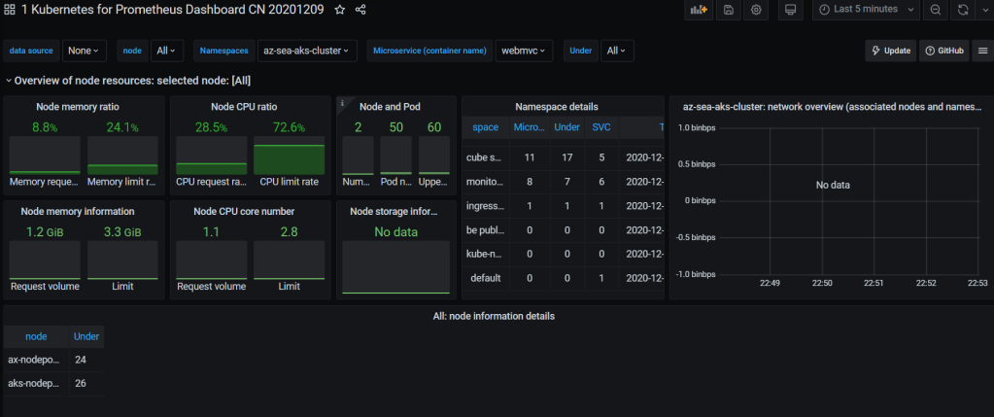
Graphana Pre-Built dashboard

Slide 65
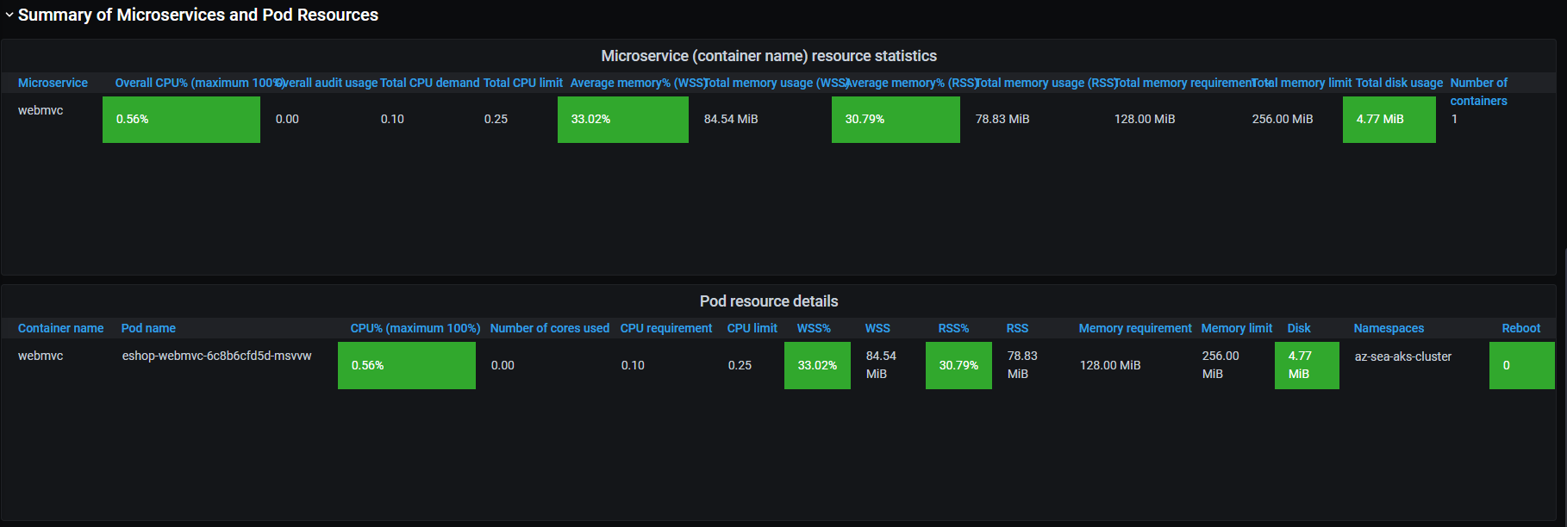
POD Details
Show Details of one of Pod webmvc The webmvc Pod has been filtered for clarity

Slide 66
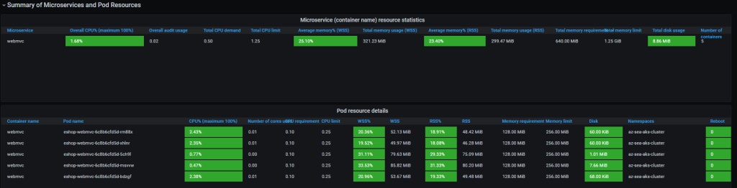
I use Apache Jmeter to perform a load test on the website deployed on AKS with /webmvc prefix here are the results that show up in the next 5 mins and webmvc containers gets scaled to 5 pods as shown below.

Slide 67
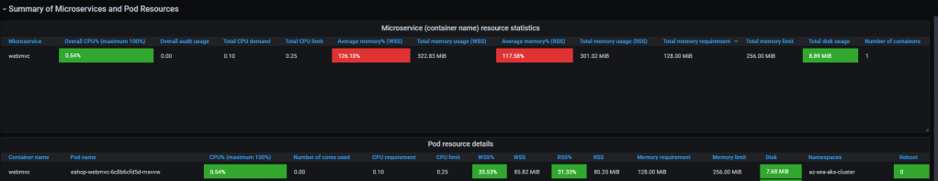
Within a span of 10 mins after the load test is completed, the scale down behaviour policy specified in the HPA.yaml with stabilizationWindowSeconds and scales the pods down to 1 from 5.

Slide 68
Event Driven Scaling

Slide 69
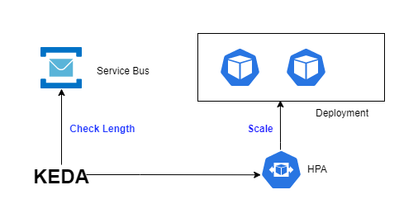
Kubernetes allows you to autoscale in various ways: horizontally, vertically, or by nodes.
All autoscaling solutions have the disadvantage of supporting only standard Kubernetes objects (deployment, stateful set, replica set) and relying on the metrics server.
Therefore, you need to use a metric adapter compatible with your data source to build autoscaling rules based on custom metrics. If you have no metric adapter available, you need to stick to resource metrics (CPU or memory).
Notes:
KEDA Register itself as Metric Adopter

Slide 70
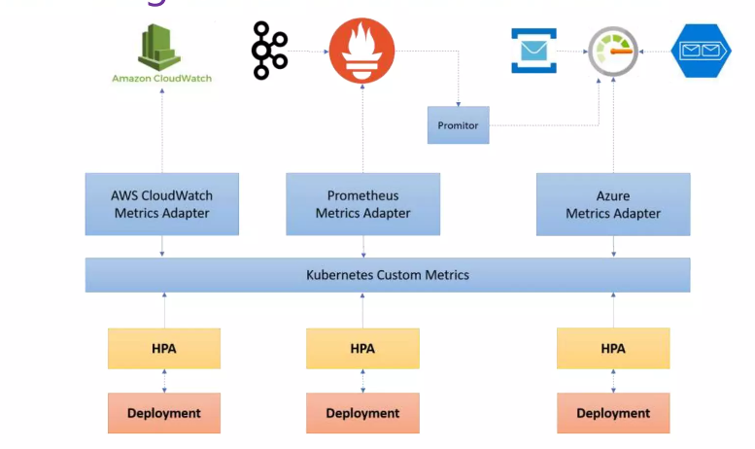
Autoscaling Based on External source

Slide 71
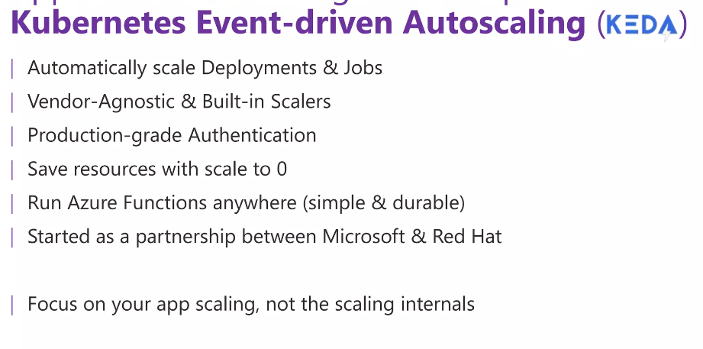

Slide 72
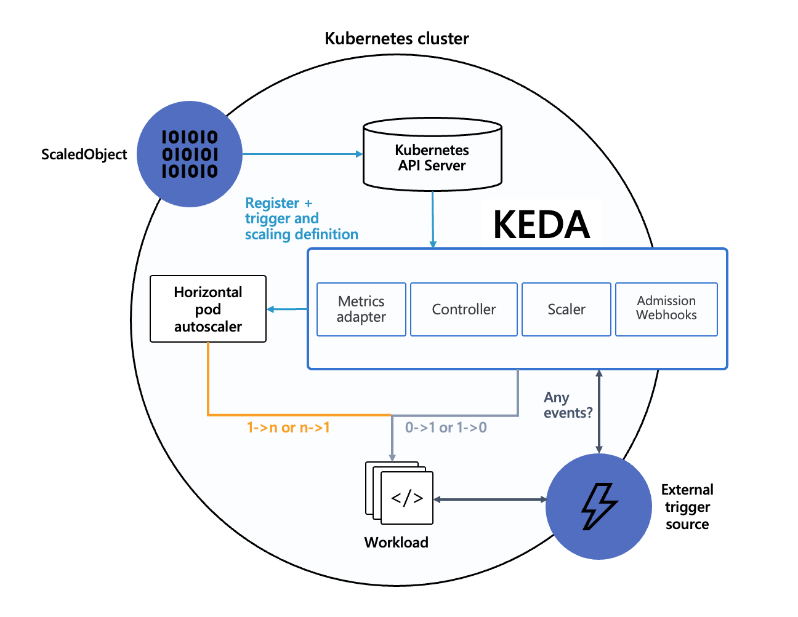
KEDA Component
External Event Source: This could be a queue, topic, or any other source of events that KEDA can monitor.
KEDA Operator: This component monitors the event source and retrieves the current event count or metric value.
KEDA Scaler: This component calculates the desired number of replicas based on the event count and scaling rules.
HPA Update: KEDA updates the HPA with the desired replica count.
AKS Pod Scaling: The HPA instructs AKS to scale the pods for the deployment.
Pod Deployment: AKS creates or removes pods as needed.
Feedback Loop: The updated pod count affects event processing, which is reflected in the event source. KEDA continuously monitors and adjusts the replica count.

Slide 73
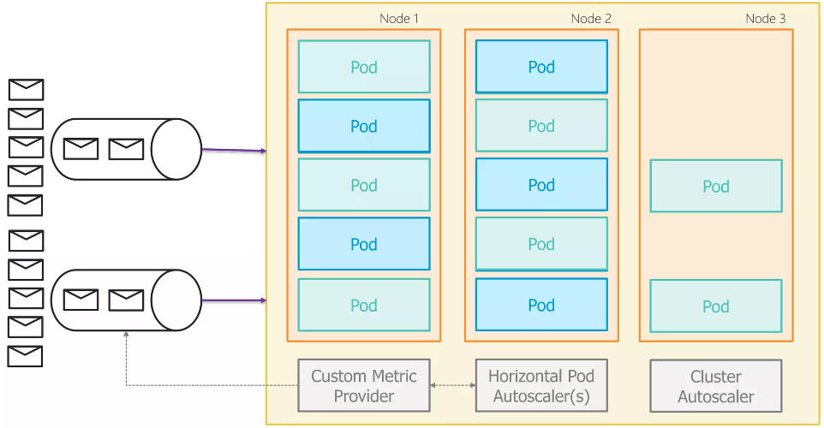
KEDA Flow
Events are generated by the external event source.
The KEDA operator detects the events and retrieves
the event count.
The KEDA scaler calculates the desired number of
replicas based on the event count and scaling rules.
KEDA updates the HPA with the desired replica count.
The HPA instructs AKS to scale the pods for the
deployment.
AKS creates or removes pods as needed to match the
desired replica count.
The updated pod count affects the event processing
rate, which is reflected in the event source.
KEDA continuously monitors the event source and
adjusts the replica count as needed, creating a feedback loop for dynamic scaling.

